Slide 1




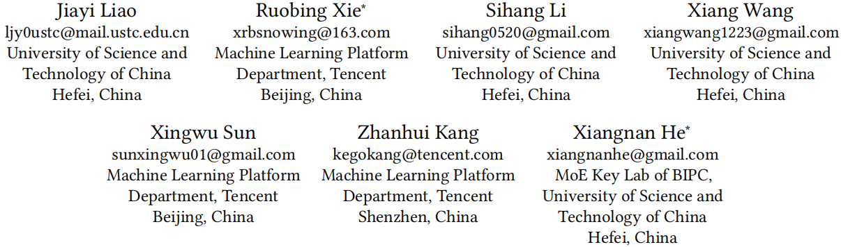





ATAI
Advanced Technique of Artificial Intelligence
ATAI
ChongqingUniversity _{AdvancedTechniqueof}
of Technology Artificial Intelligence
Chongqing University of
Technology
Chongqing University ^{ATAI}
_{of Technology} Advanced Techniqueof
Artificial Intelligence
Chongqing University of Technology
Chongqing University of Technology
Multi-Grained Patch Training for Efficient LLM-based Recommendation
Code: https://github.com/ljy0ustc/PatchRec
——SIGIR_2025
Reported by Long Zhang
1

Slide 2
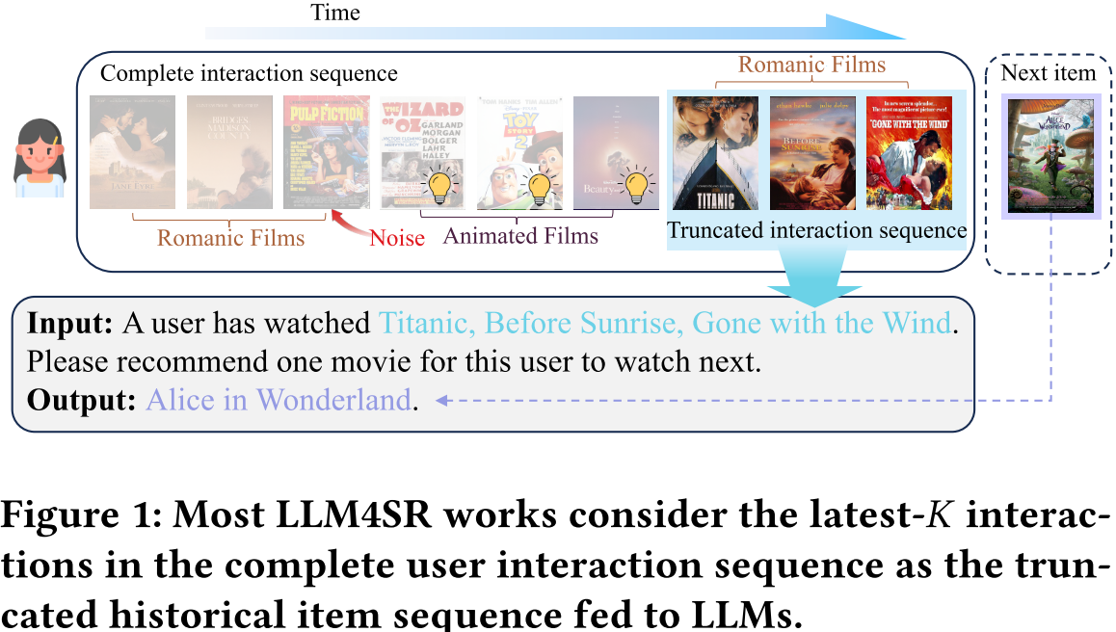
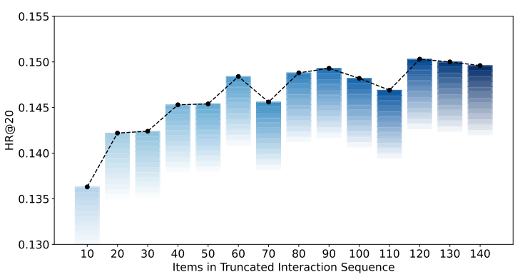
ATAI
Advanced Technique of Artificial Intelligence
ATAI
ChongqingUniversity _{AdvancedTechniqueof}
of Technology Artificial Intelligence
Chongqing University of
Technology
Chongqing University ^{ATAI}
_{of Technology} Advanced Techniqueof
Artificial Intelligence
Chongqing University of Technology
Chongqing University of Technology
Motivation
Existing approaches have to truncate item history in the prompt, focusing only on recent interactions and sacrificing
the ability to model long-term history.
1) Temporal significance of interactions: Such compressed repre-sentations do not explicitly regard the temporal distinctions of relevance.
2) Comprehension of compression patterns: While compressed item and session patches retain the same dimensionality as original textual tokens, LLMs lack inherent understanding of them.

Slide 3
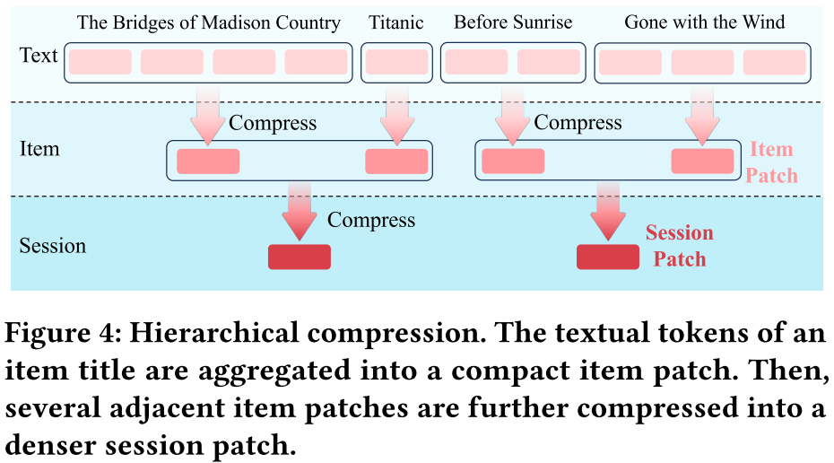



ATAI
Advanced Technique of Artificial Intelligence
ATAI
ChongqingUniversity _{AdvancedTechniqueof}
of Technology Artificial Intelligence
Chongqing University of
Technology
Chongqing University ^{ATAI}
_{of Technology} Advanced Techniqueof
Artificial Intelligence
Chongqing University of Technology
Chongqing University of Technology
Method

Slide 4
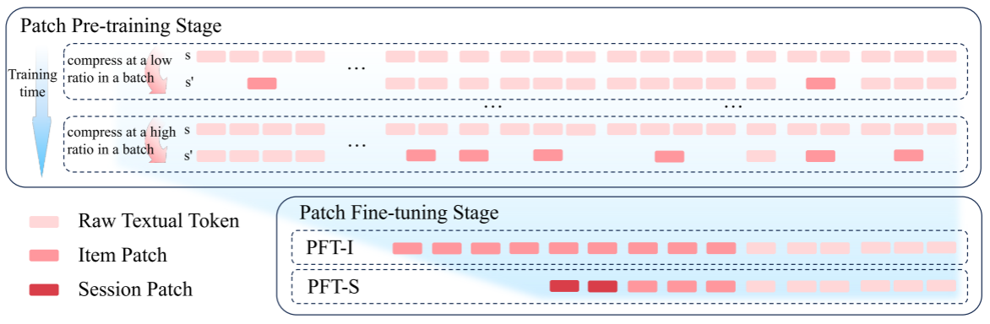

ATAI
Advanced Technique of Artificial Intelligence
ATAI
ChongqingUniversity _{AdvancedTechniqueof}
of Technology Artificial Intelligence
Chongqing University of
Technology
Chongqing University ^{ATAI}
_{of Technology} Advanced Techniqueof
Artificial Intelligence
Chongqing University of Technology
Chongqing University of Technology
Method

Slide 5
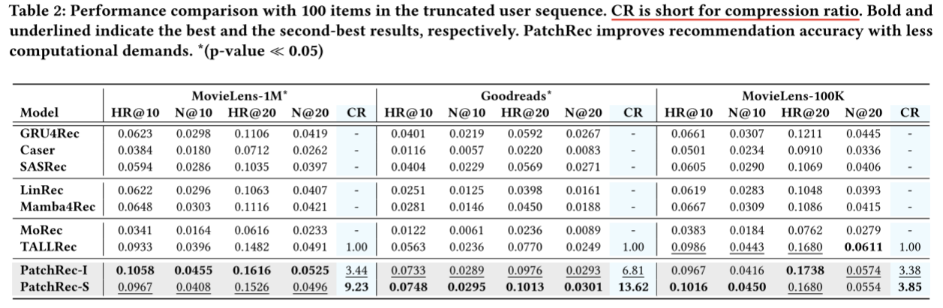
ATAI
Advanced Technique of Artificial Intelligence
ATAI
ChongqingUniversity _{AdvancedTechniqueof}
of Technology Artificial Intelligence
Chongqing University of
Technology
Chongqing University ^{ATAI}
_{of Technology} Advanced Techniqueof
Artificial Intelligence
Chongqing University of Technology
Chongqing University of Technology
Experiments
Llama-3.2-1B-Instruct as the backbone LLM

Slide 6
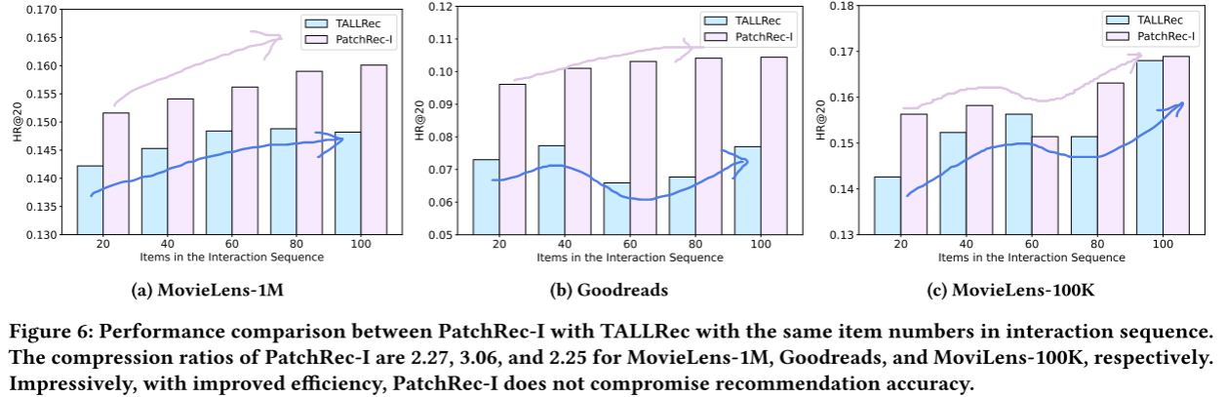
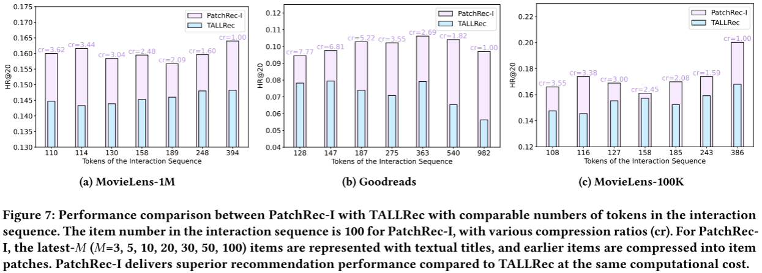
ATAI
Advanced Technique of Artificial Intelligence
ATAI
ChongqingUniversity _{AdvancedTechniqueof}
of Technology Artificial Intelligence
Chongqing University of
Technology
Chongqing University ^{ATAI}
_{of Technology} Advanced Techniqueof
Artificial Intelligence
Chongqing University of Technology
Chongqing University of Technology
Experiments

Slide 7
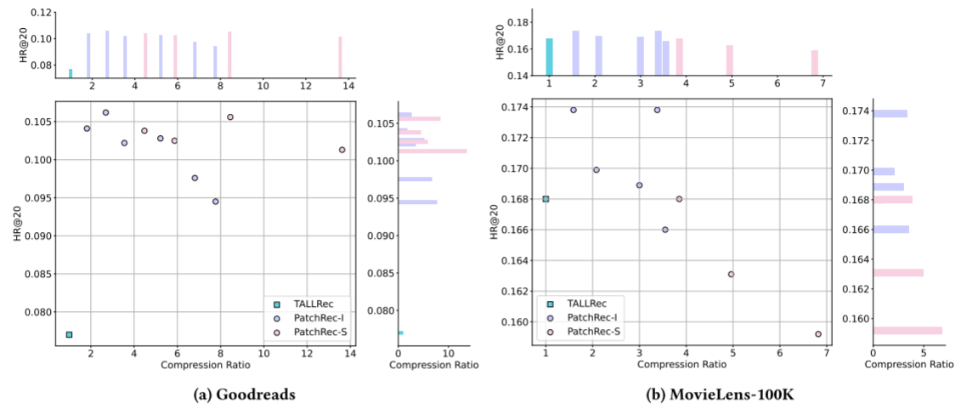
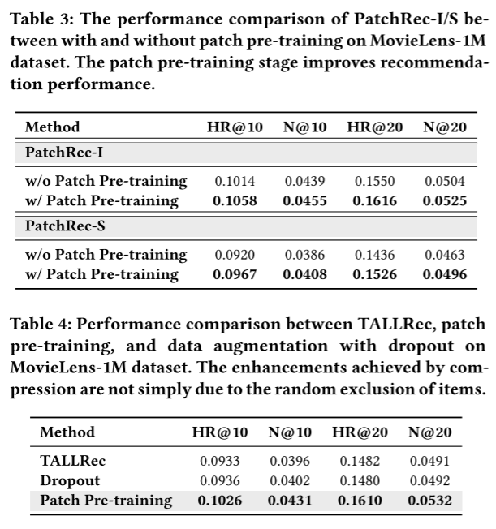
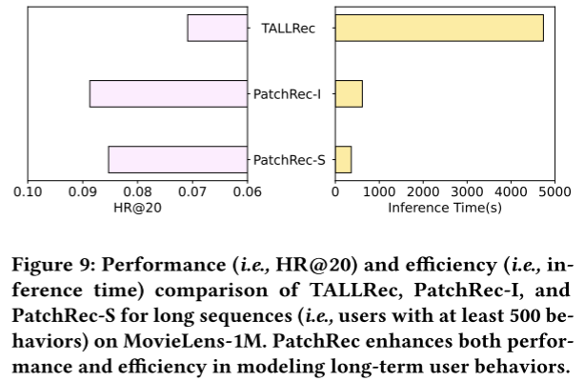
ATAI
Advanced Technique of Artificial Intelligence
ATAI
ChongqingUniversity _{AdvancedTechniqueof}
of Technology Artificial Intelligence
Chongqing University of
Technology
Chongqing University ^{ATAI}
_{of Technology} Advanced Techniqueof
Artificial Intelligence
Chongqing University of Technology
Chongqing University of Technology
Experiments

Slide 8


ATAI
Advanced Technique of Artificial Intelligence
ATAI
ChongqingUniversity _{AdvancedTechniqueof}
of Technology Artificial Intelligence
Chongqing University of
Technology
Chongqing University ^{ATAI}
_{of Technology} Advanced Techniqueof
Artificial Intelligence
Chongqing University of Technology
Chongqing University of Technology
Thanks!

